Slide 1
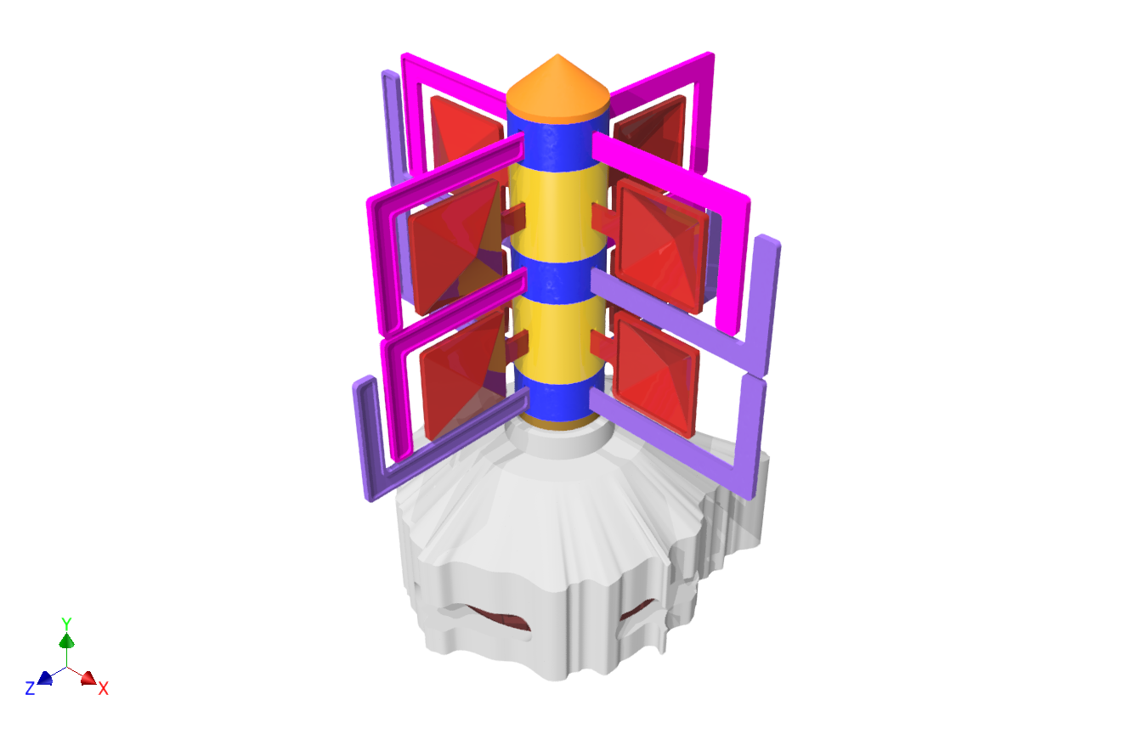





GRADO EN INGENIERÍA EN DISEÑO INDUSTRIAL
Y DESARROLLO DE PRODUCTOS
Proyecto ERASMUS +
EDUcating through Sustainable DEMOnstrators
TRABAJO DE FIN DE GRADO
26 DE JUNIO DE 2024
Autora: Patricia Er López Marrero
Tutor 1: Pedro Manuel Hernández Castellano
Tutora 2: Annabella Narganes Pineda

Slide 2
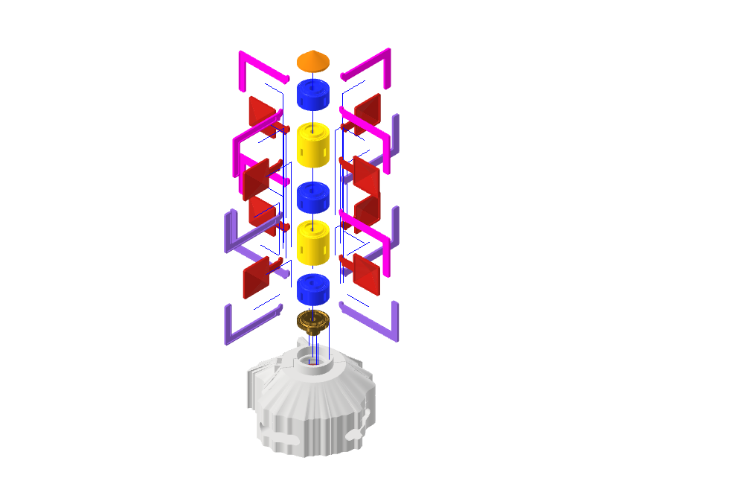
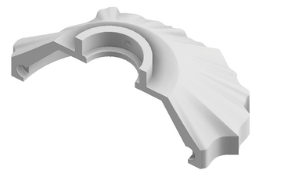
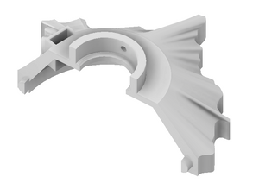
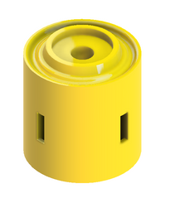
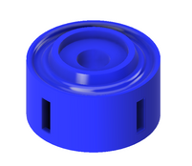
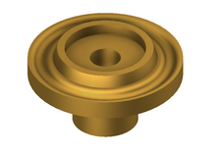
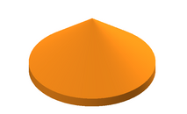
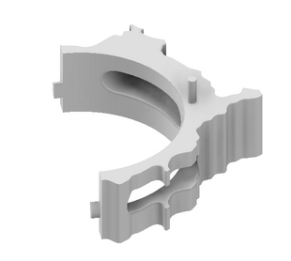
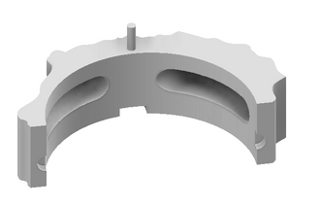
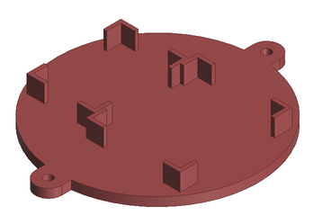
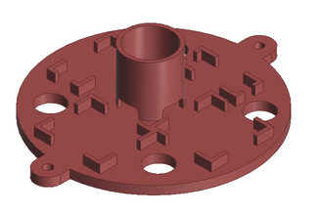
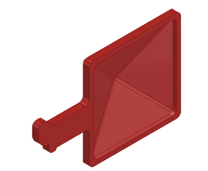
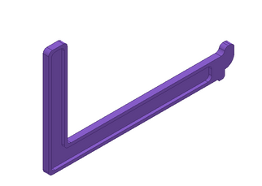
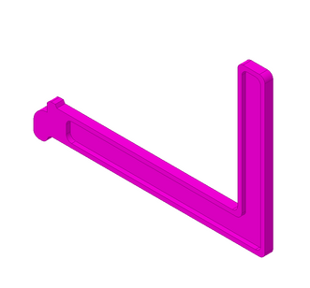


1
2
3.5
4
5
Wind Demonstartor
33 pieces
x2
x3
259 mm
Cylinders
x8
x6
x6
Base with electronics
Blades
217 mm

Slide 3

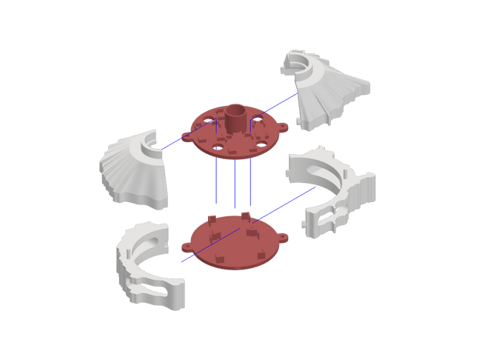
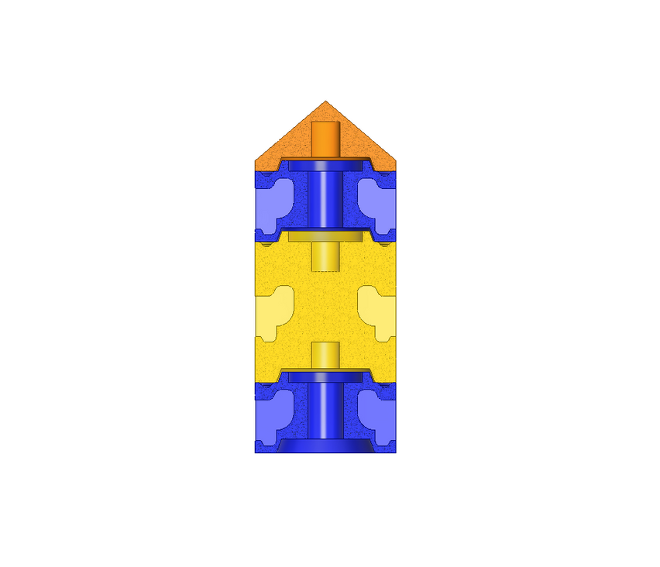
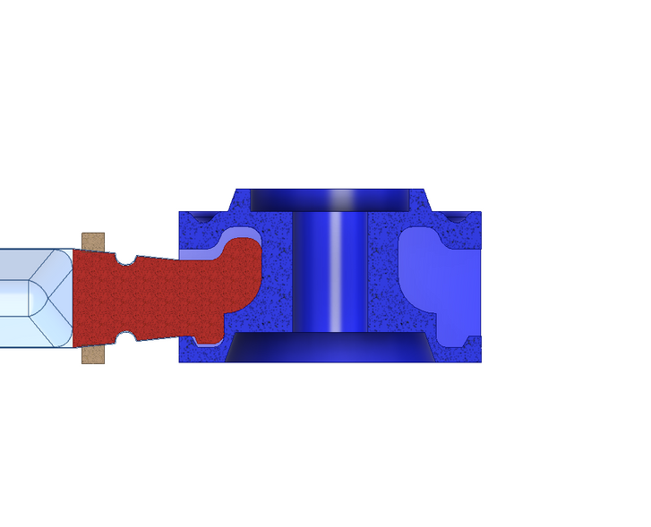


Assembly
Wood joints
Base assembly
Cylinders assembly
Blades - cylinders assembly
Top view

Slide 4
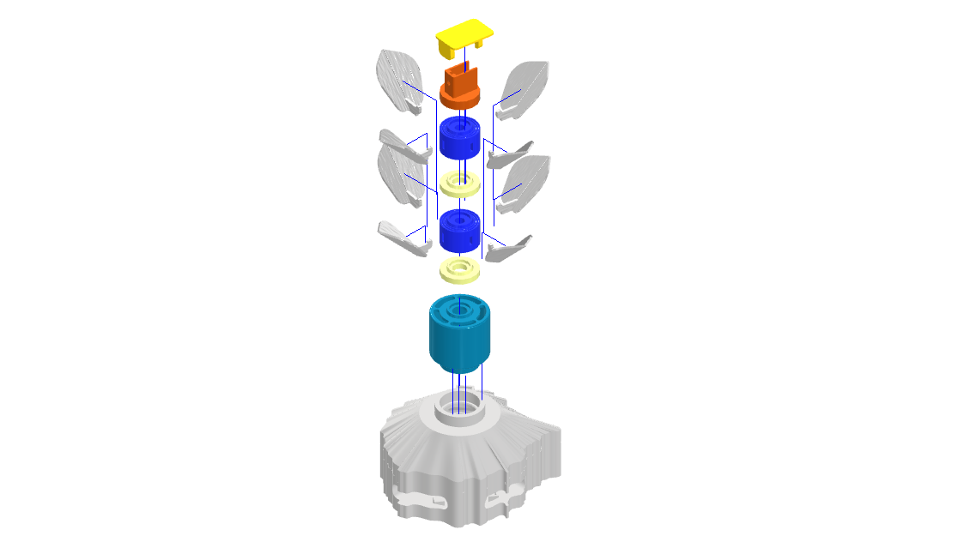
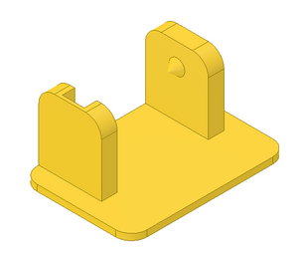
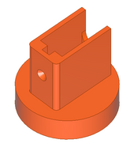
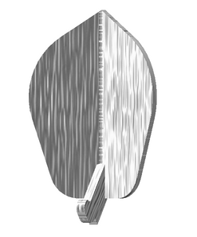
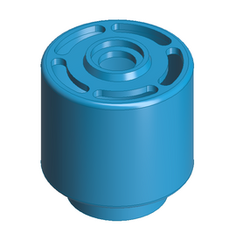
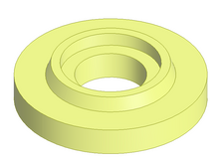
1
2
3.5
4
5
Water + Solar Demonstrator
21 pieces
250 mm
Solar parts
x8
x2
x2
Base with electronics
Water parts
166 mm

Slide 5
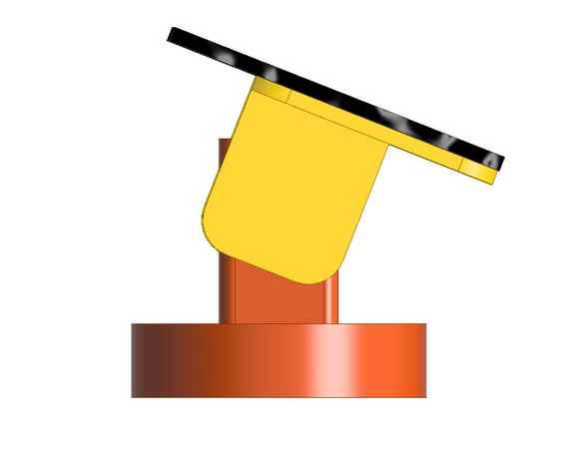

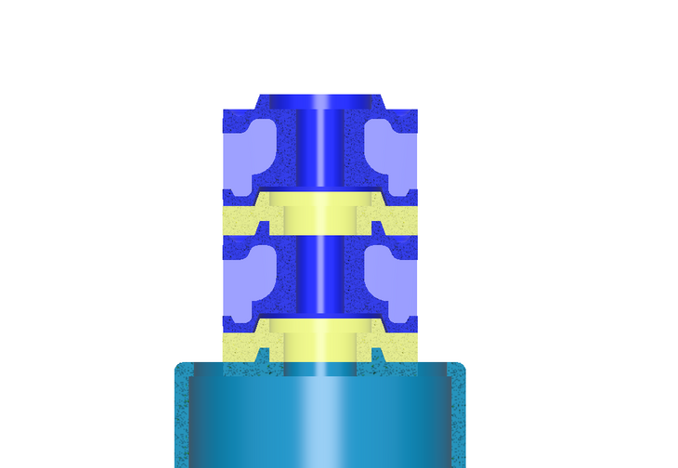

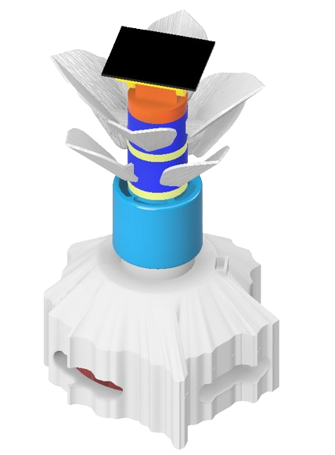

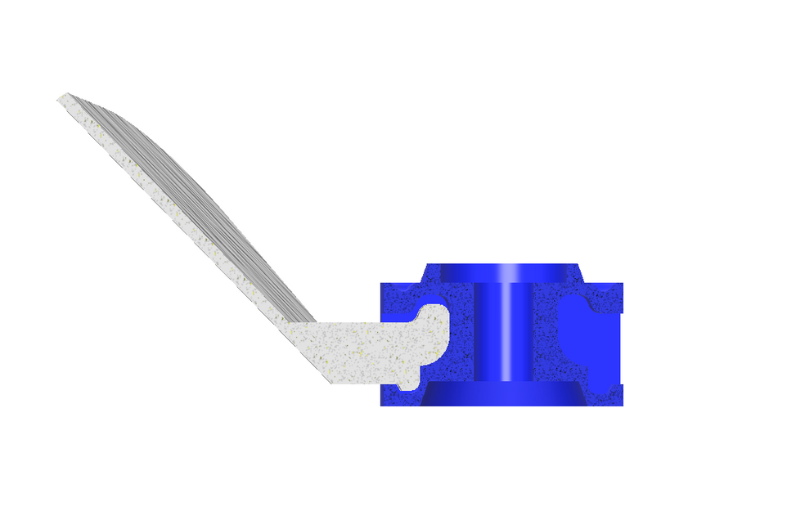

Assembly
Solar parts assembly
Cylinders assembly
Condensation
Leaf - cylinder assembly
Top view

Slide 6

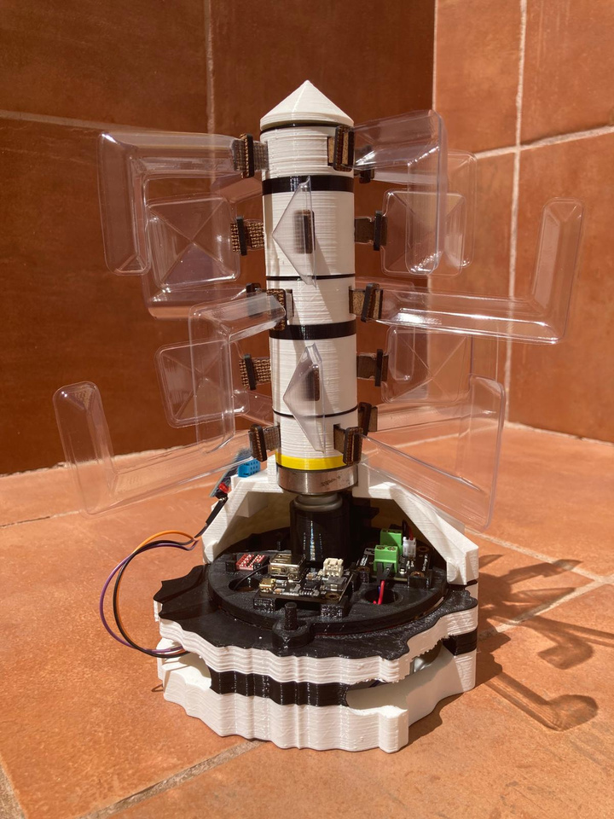
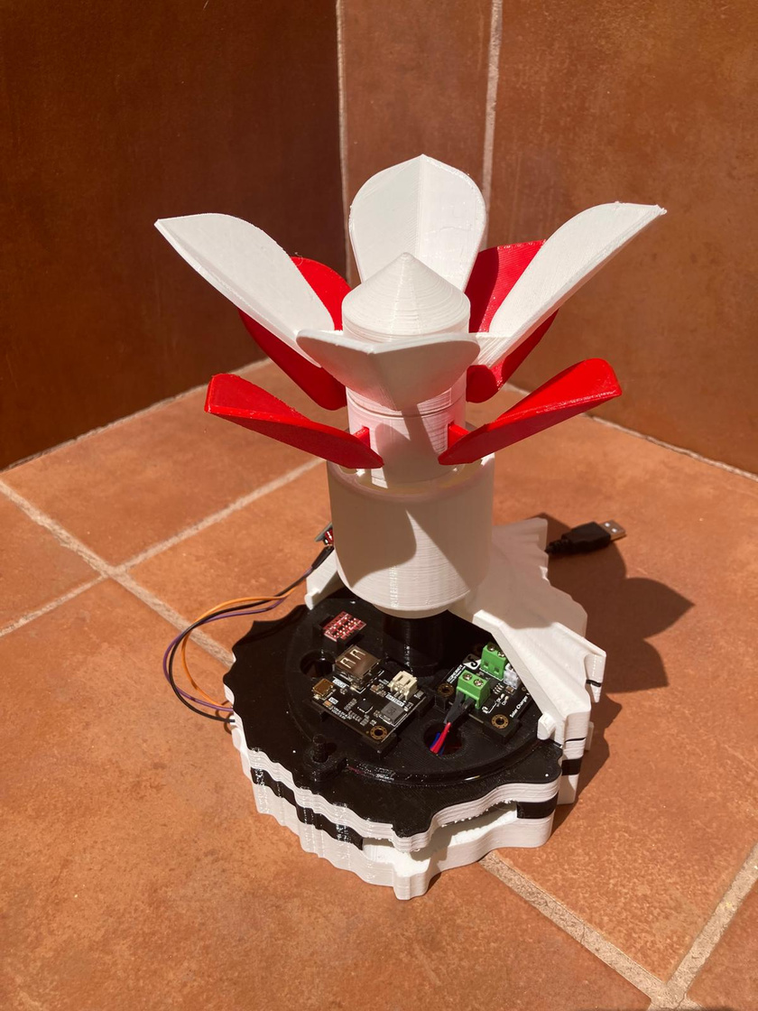
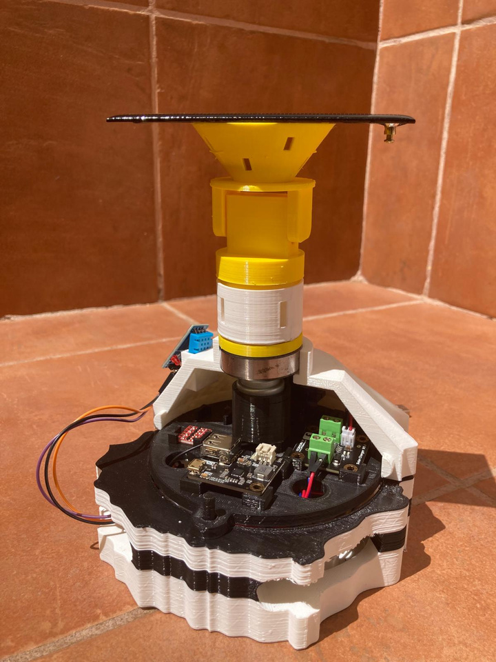
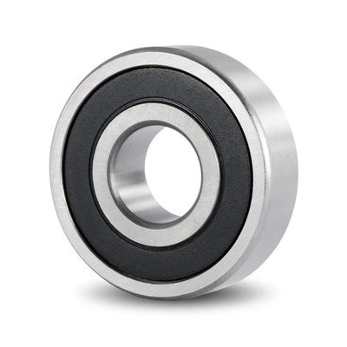
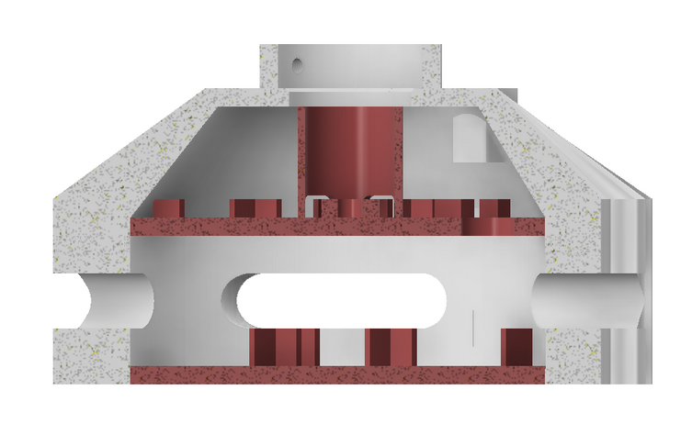
Prototypes with electronics
Combine
Bearing
Half section view of the base

Slide 7
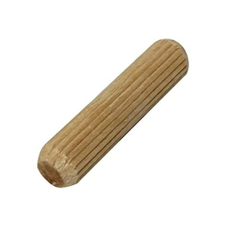
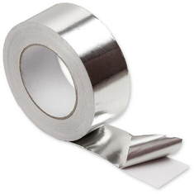
Other element specifications
exterior Ø 40 mm
Bearing ZZ type
Height 12 mm
1 unit
interior Ø 17 mm
Wood joints
Ø 8 mm
Height 40 mm
3 units
Aluminum foil tape
1 unit

